Slide 1







SHOPNOVA E-COMMERCE ANALYTICS DASHBOARD
Analyze sales performance, regional customer behaviors, product profit margins and drivers to optimize Shopnova’s quarterly revenues.
Team Members:
Yash Mundhe
Ashish Raj
Rohit Chauhan
Armaan
Shravani
Vaishnavi

Slide 2





Tools & Technologies Used:
Excel
Tableau
Data analysis, PivotTables, KPIs, and foundational trend examination.
Interactive visualizations and deep operational metric breakdowns.
Power BI
MySQL Workbench
Interactive executive dashboards and dynamic KPI performance analysis.
Data querying, schema relational modeling, and strict KPI validation.

Slide 3





Project Objectives:
Sales & Revenue Tracking
Customer Segmentation
Product Performance
Monitor total gross sales, net profit margins, and order volume trends across multiple product lines.
Identify high-value customer groups and analyze lifetime value to optimize retention campaigns.
Evaluate category-wise profitability and inventory turnover rates to prevent costly stockouts.
Regional Expansion
Seasonal Identification
Automated BI
Pinpoint top-performing geographic markets to guide regional marketing and fulfillment strategies.
Analyze order patterns and demand surges during major holiday seasons like Q4 promotional windows.
Establish robust SQL-to-Dashboard pipelines enabling real-time executive decision making via Power BI.

Slide 4
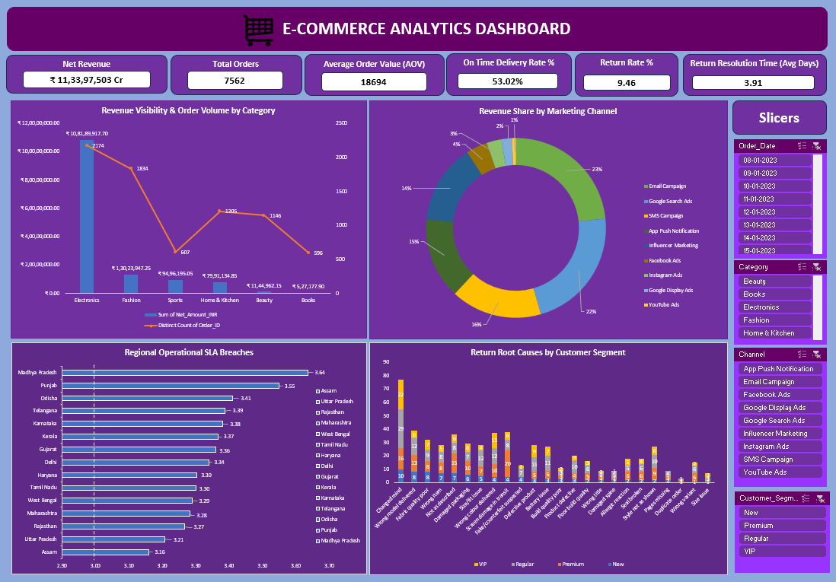
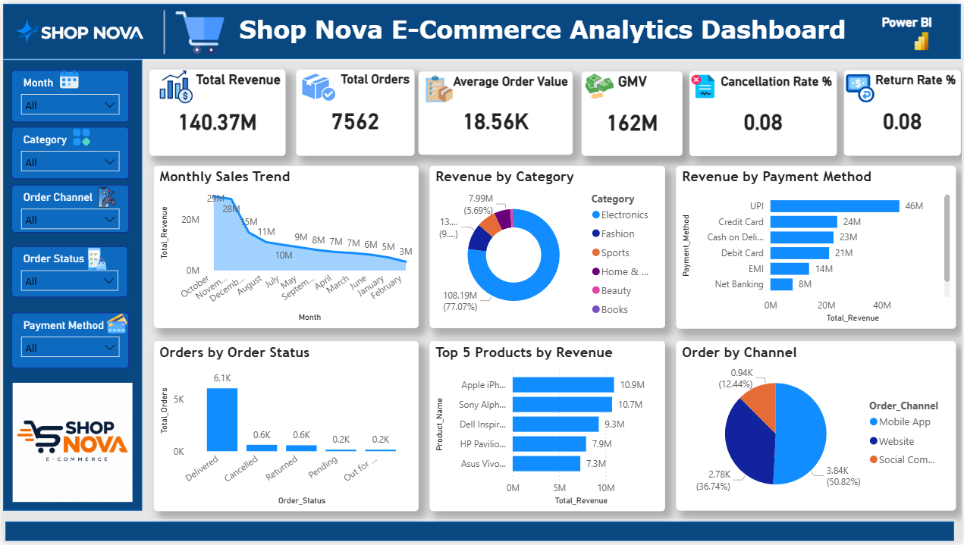
Dashboards & SQL Analysis:
Excel Analysis
PivotTables, KPIs & trend analysis
Power BI Dashboard
KPI monitoring & interactive analysis

Slide 5
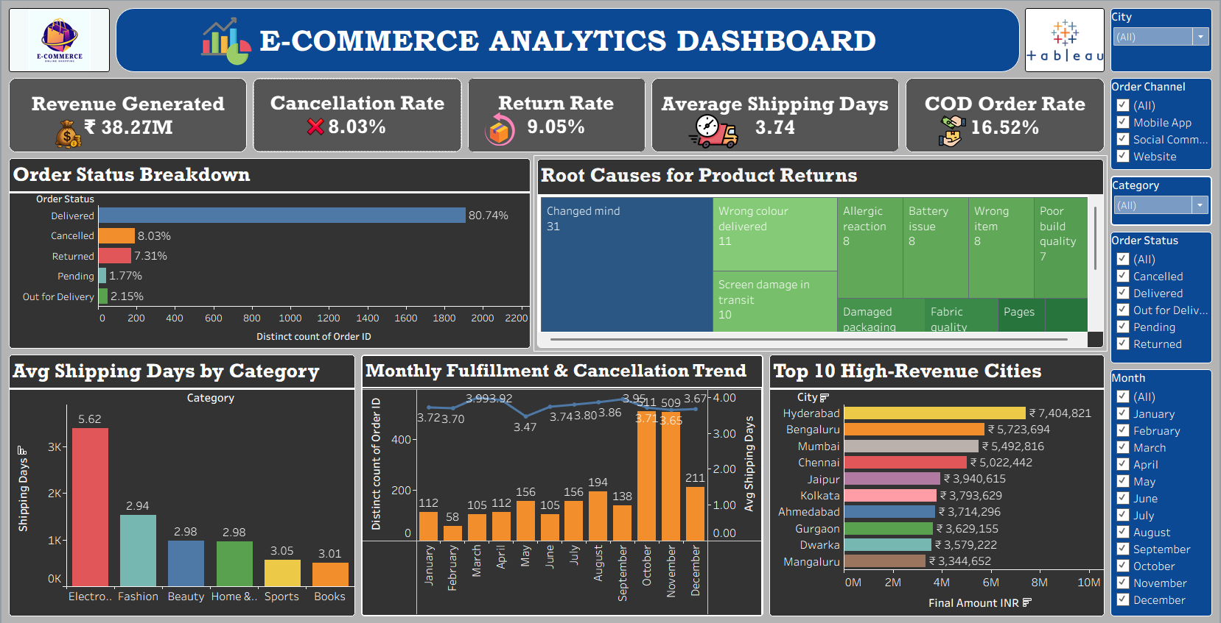
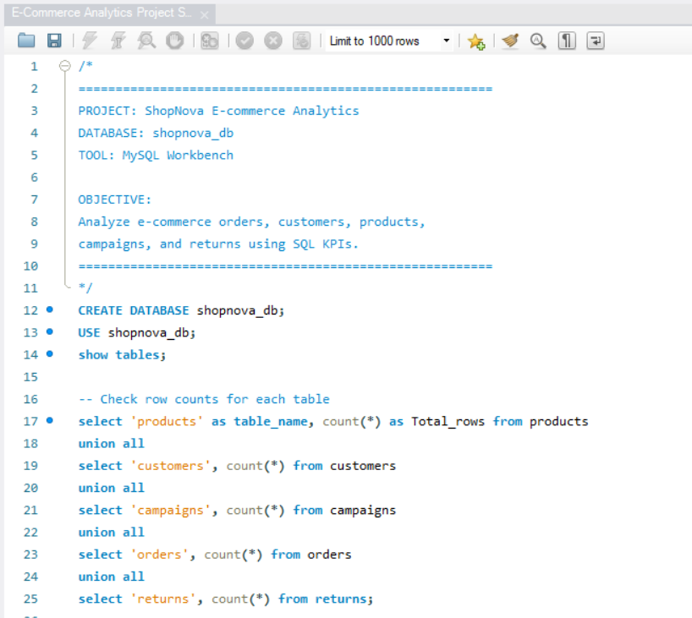
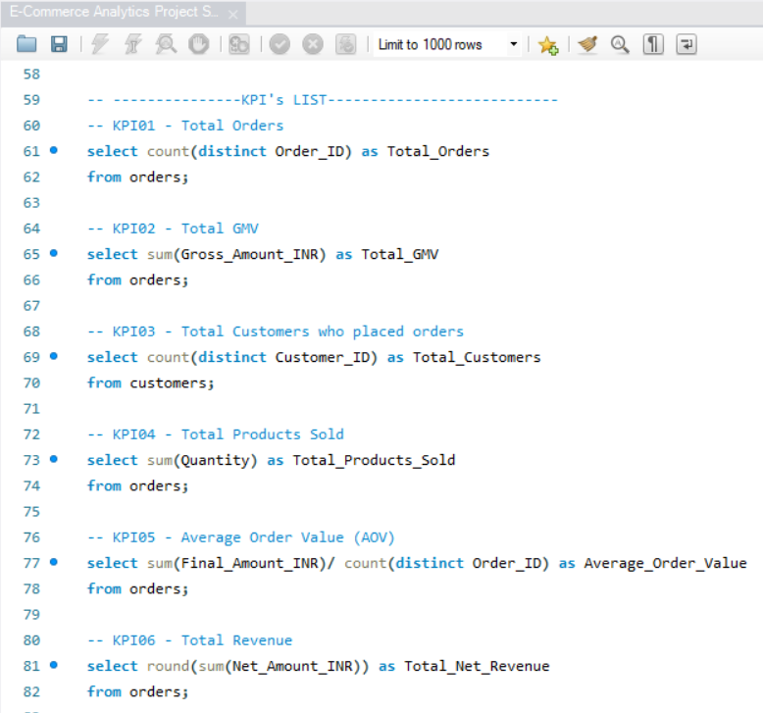
Tableau Dashboard
Interactive performance visualization
SQL Analysis
Data validation & KPI calculations

Slide 6

Major Challenges Faced:
Combining Different Data Sources
Cleaning Messy Data
Bringing together separate data files (customer details, product lists, sales records) so they work nicely in one system.
Fixing missing information, removing duplicates, and ensuring consistent date and product name formatting.
Setting Up Database Links
Tracking Sales Steps
Connecting different MySQL tables correctly so that complex queries and reporting run without performance errors.
Following the customer purchasing journey step-by-step to identify where drop-offs happen before final checkout.
Keeping Dashboards Fast
Organizing Product Categories
Designing comprehensive reports in Excel, Tableau, and Power BI that load instantly under heavy record sets.
Grouping hundreds of different inventory items into clean, logical product categories for effortless reporting.

Slide 7

Major Business Insights:
Top-Selling Products
Cart Abandonment
A small group of popular products drives most total sales, while a large inventory portion sells rarely.
Many users abandon items before purchase, often triggered right when shipping costs or final checkout steps appear.
Discount Impact
Customer Types
While massive discounts increase order volume, they significantly compress the net profit margin per transaction.
Regular loyal buyers demonstrate distinct purchasing behavior compared to one-time deal-driven shoppers.
Sales Locations
Traffic Sources
Certain cities and regions generate a much higher density of incoming orders than other geographic zones.
Direct visitors and natural organic search users tend to buy more items than users arriving from social media ads.

Slide 8

Actionable Recommendations:
Focus on Loyal Customers
Improve the Checkout Page
Reward repeat buyers with special perks instead of relying solely on heavy sitewide discounts that hurt overall profit.
Display shipping fees earlier in the shopping journey so customers are not surprised right at the final step.
Manage Stock Better
Smart Marketing Spending
Keep sufficient inventory of best-selling items in stock to prevent stockouts and missed sales opportunities.
Invest more advertising budget into channels and traffic sources that bring in customers who actually convert.
Better Data Habits
Friendly Follow-ups
Regularly clean and organize data files to keep reports completely accurate as transaction volume scales.
Send automated reminder emails or messages to customers who left items in carts to encourage checkout completion.

Slide 9

Thank You!

